Slide 1
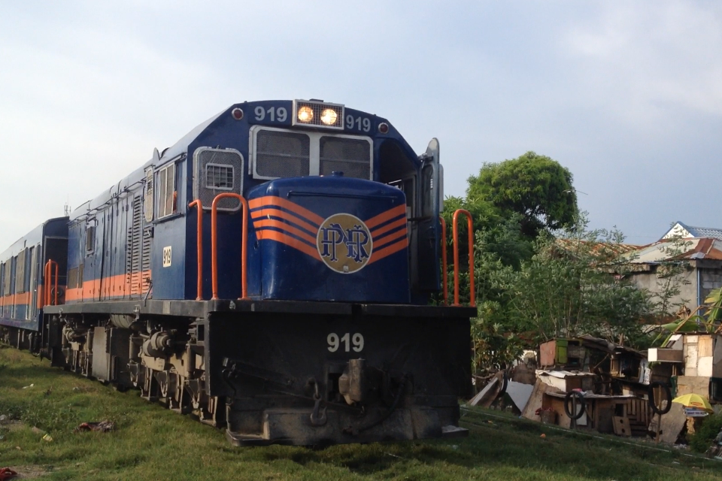
PNR Commuters Manalang || Timo
Notes:
Commuting has been a part of the daily life of every Filipino – from students to teachers, workers, etc. Rest assure that most Filipinos have experienced commuting at least a few times in their life, and some of those experience may be something they don’t want to experience anymore – it could from any public transportation that is available in the country.
There are various ways to commute but for this specific activity, the observers will focus with the Philippine National Railway (PNR) commuters as their subject.

Slide 2
1.
Need Finding
Questions
Interviewees’ Insights
User need breakdown
Point of view

Slide 3
How often do you ride the train?
Why ride it other than the other public transportation available in our disposal?
Give us any suggestions that you think can help PNR improve and make it a more effective public transportation in the future.
Questions

Slide 4

Angelica Mendoza || 28 years old || Programmer
Once a month
Efficient, less traffic – can reach many destinations, and fare is cost-effective than the others
Airconditioning units, impose stricter rules when it comes to the loading and unloading process.
Interviewee Insights

Slide 5

Zenaida Chavez || 20 years old || Student
Occasionally
Trains are much faster and less hassle
More train trams for more people to enjoy
Interviewee Insights

Slide 6

Rommel Ormita || 20 years old || Student
Every other day
I consider riding jeepneys and buses, but PNR is more convenient for me.
Have more trains to have more timeslots. Integrate beep system, innovate the trains because most of it are already old.
Interviewee Insights

Slide 7
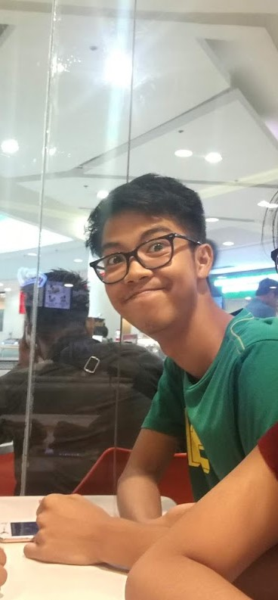
Inspire Manalang || 17 years old || Student
Everyday, when I go to school
I find it cheaper and efficient than the others.
Proper maintenance of the railways, shorter interval of train arrivals.
Interviewee Insights

Slide 8
Commuters need a way to ride the train comfortably.
Commuters need to be able to avoid long waiting lines.
Commuters need a way to avoid the huge crowd in train stations.
Commuters need a way to not worry about the train interval schedule.
Commuters need to be able to have their tickets in advance.
User needs

Slide 9
Proper organization and developing more effective and efficient ways that can greatly impact everyday travel of train commuters.
Point of view

Slide 10
2.
Story board

Slide 11
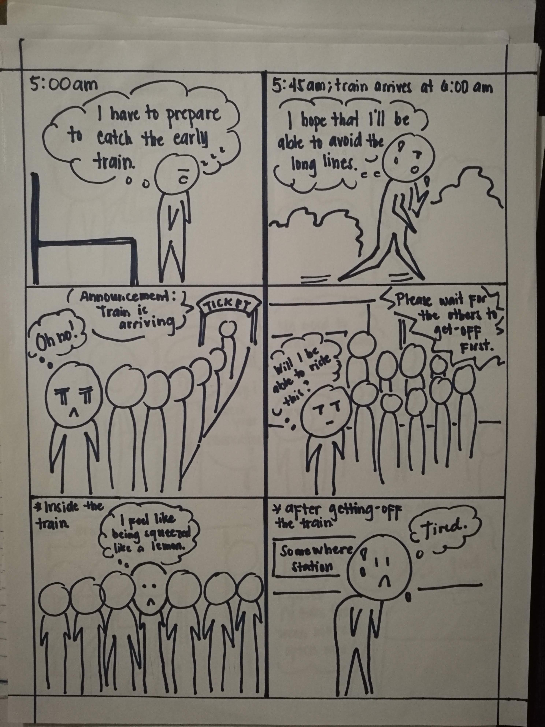
Storyboard 1

Slide 12
Storyboard 1

Slide 13
Storyboard 1

Slide 14
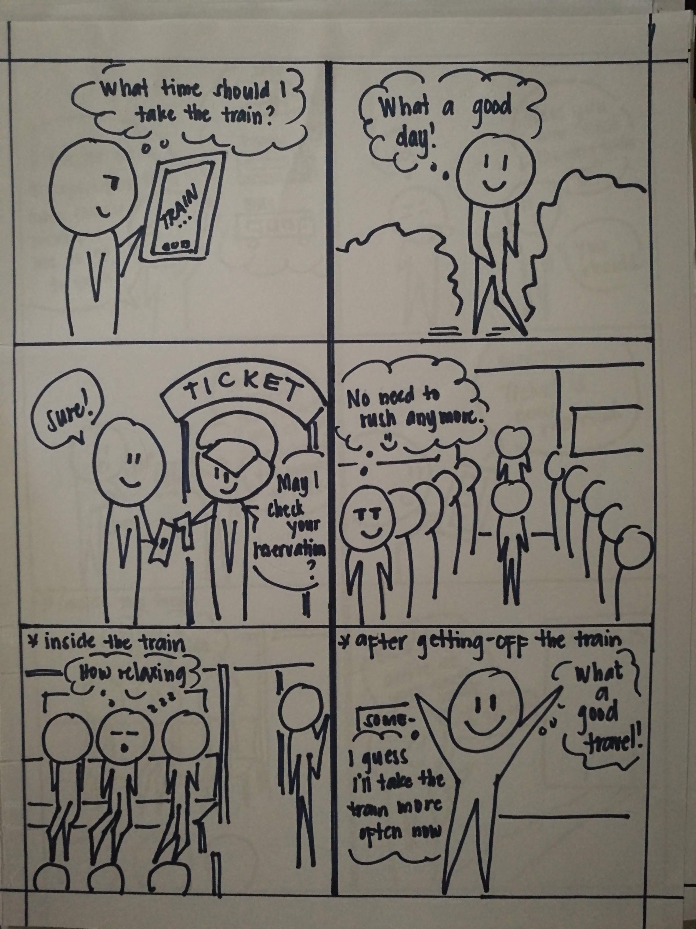
Storyboard 2

Slide 15
Storyboard 2

Slide 16
Storyboard 2

Slide 17
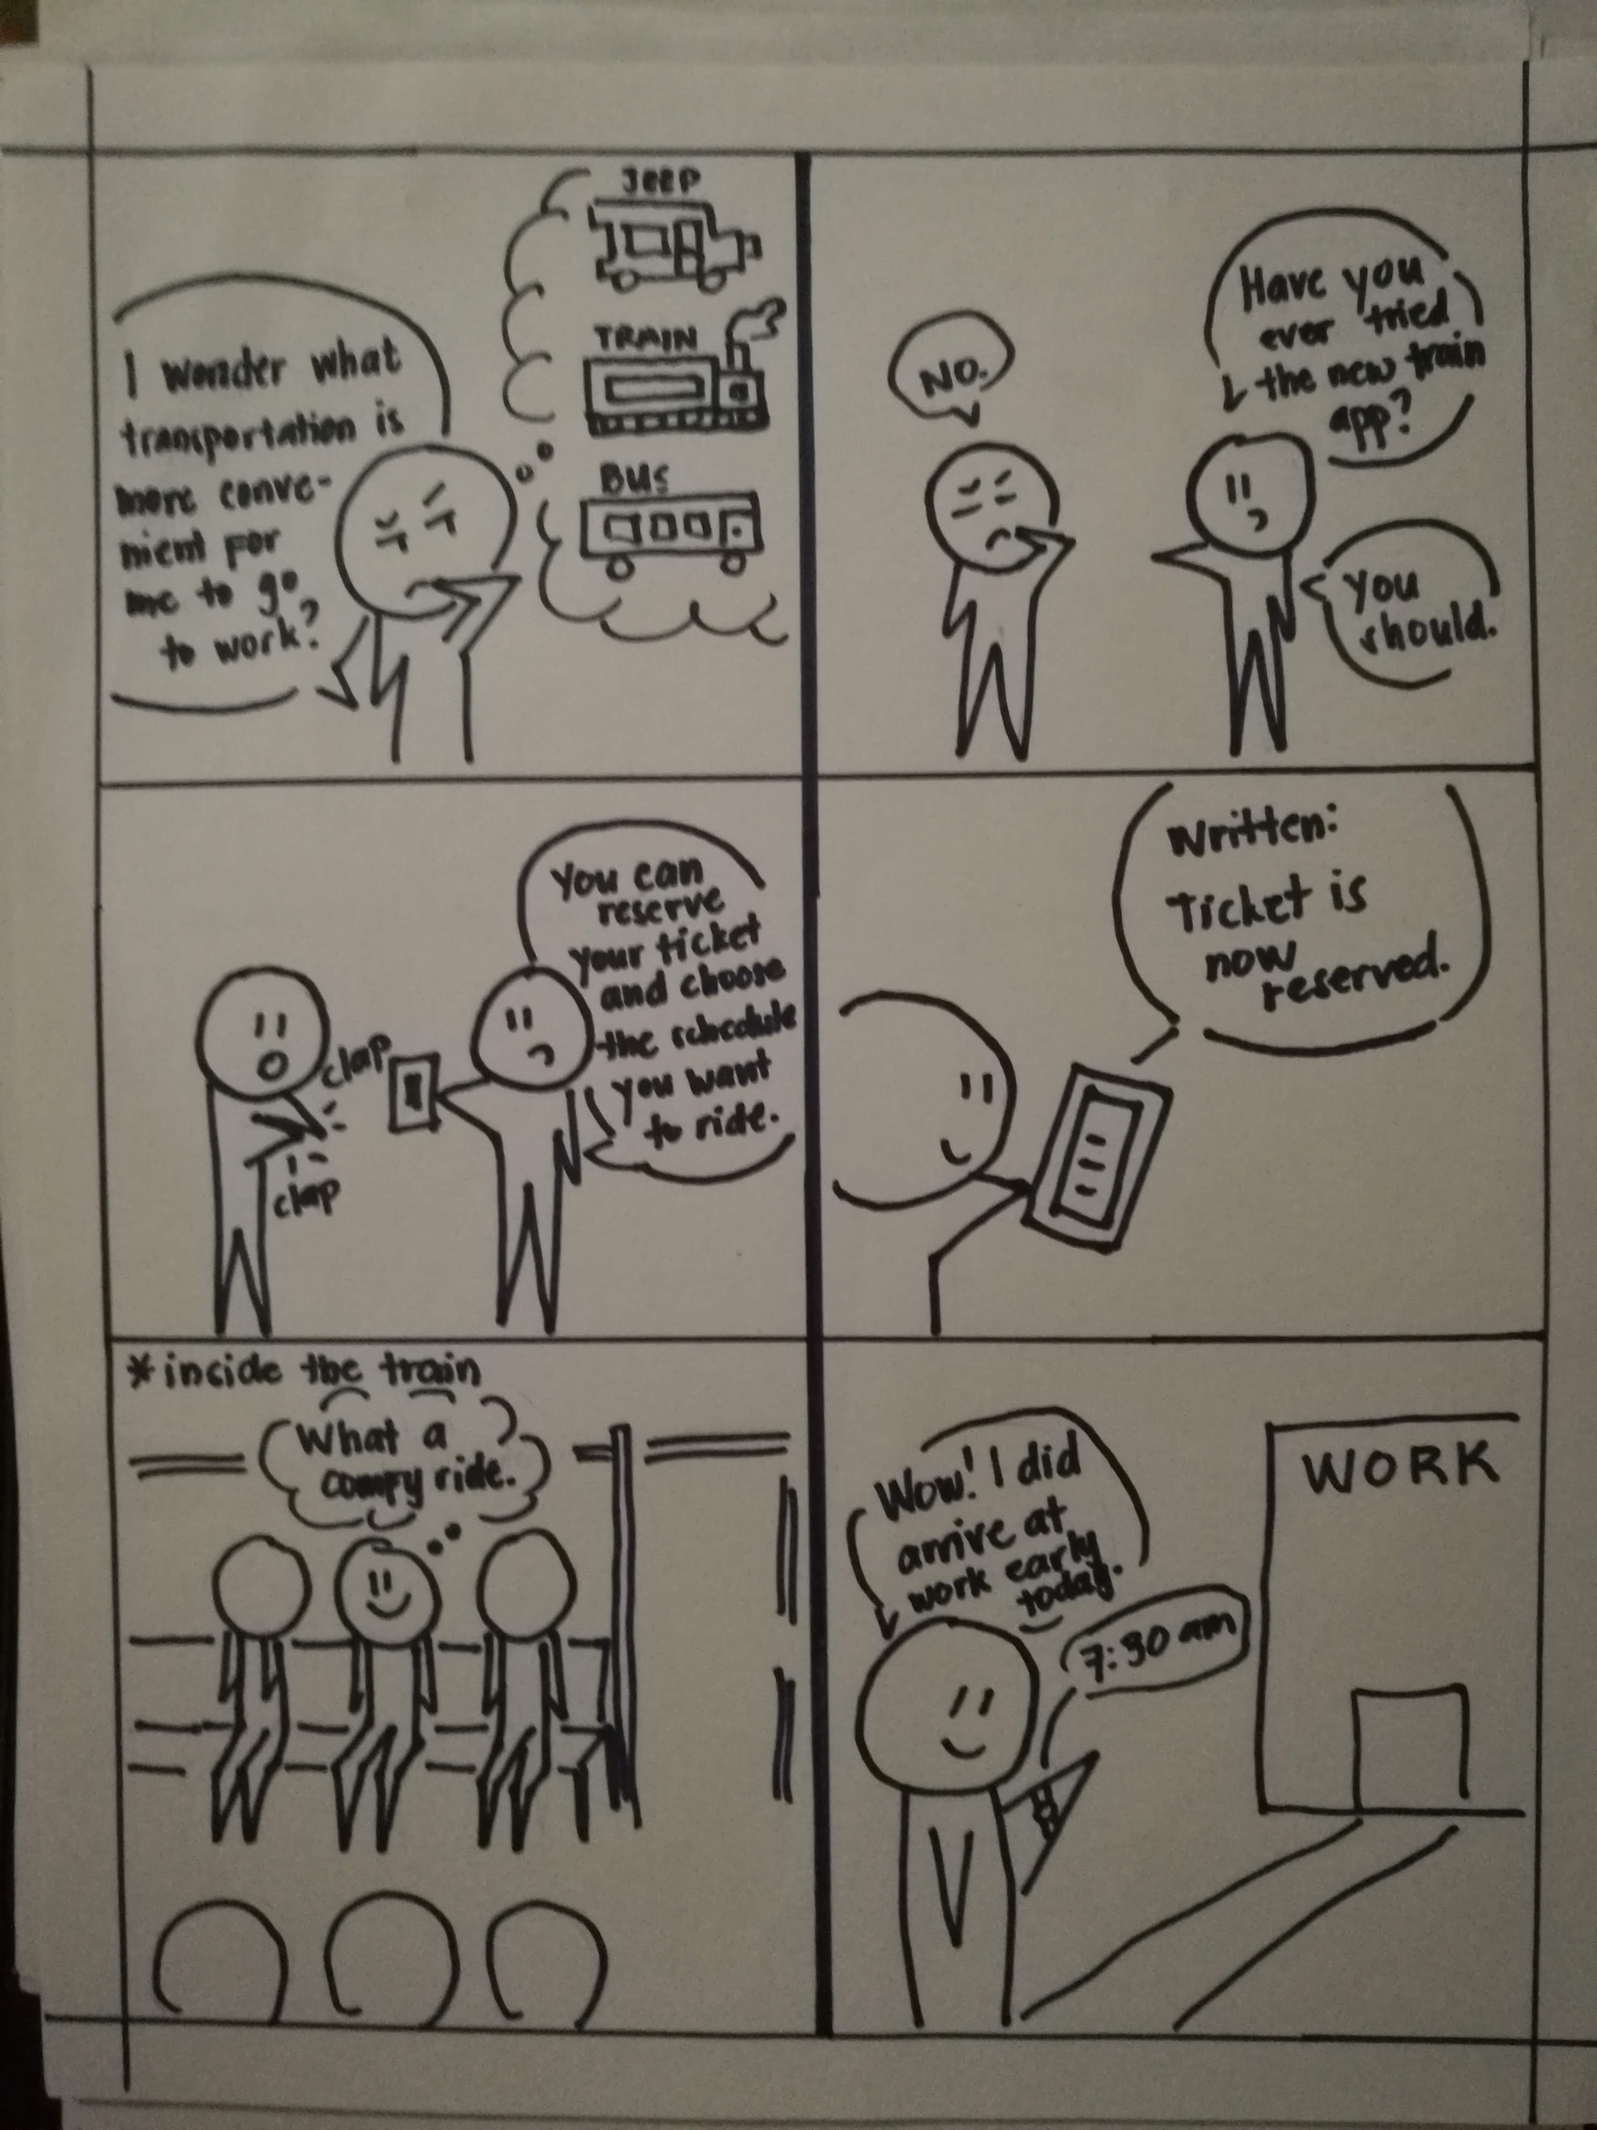
Storyboard 3

Slide 18
Storyboard 3

Slide 19
Storyboard 3

Slide 20
3.
Prototype
Notes:
Demo with the interviewees (prototype 1 and 2)

Slide 21
Prototype 1

Slide 22
INSTRUCTIONS FOR USE
EDIT IN GOOGLE SLIDES
Click on the button under the presentation preview that says "Use as Google Slides Theme".
You will get a copy of this document on your Google Drive and will be able to edit, add or delete slides.
You have to be signed in to your Google account.
EDIT IN POWERPOINT®
Click on the button under the presentation preview that says "Download as PowerPoint template". You will get a .pptx file that you can edit in PowerPoint.
Remember to download and install the fonts used in this presentation (you’ll find the links to the font files needed in the Presentation design slide)
More info on how to use this template at www.slidescarnival.com/help-use-presentation-template
This template is free to use under Creative Commons Attribution license. You can keep the Credits slide or mention SlidesCarnival and other resources used in a slide footer.

Slide 23
HELLO!
I am Jayden Smith
I am here because I love to give presentations. You can find me at @username

Slide 24
Quotations are commonly printed as a means of inspiration and to invoke philosophical thoughts from the reader.

Slide 25
THIS IS A SLIDE TITLE
Here you have a list of items
And some text
But remember not to overload your slides with content
Your audience will listen to you or read the content, but won’t do both.

Slide 26
BIG CONCEPT
Bring the attention of your audience over a key concept using icons or illustrations

Slide 27
YOU CAN ALSO SPLIT YOUR CONTENT
White
Is the color of milk and fresh snow, the color produced by the combination of all the colors of the visible spectrum.
Black
Is the color of coal, ebony, and of outer space. It is the darkest color, the result of the absence of or complete absorption of light.

Slide 28
IN TWO OR THREE COLUMNS
Yellow
Is the color of gold, butter and ripe lemons. In the spectrum of visible light, yellow is found between green and orange.
Blue
Is the colour of the clear sky and the deep sea. It is located between violet and green on the optical spectrum.
Red
Is the color of blood, and because of this it has historically been associated with sacrifice, danger and courage.

Slide 29
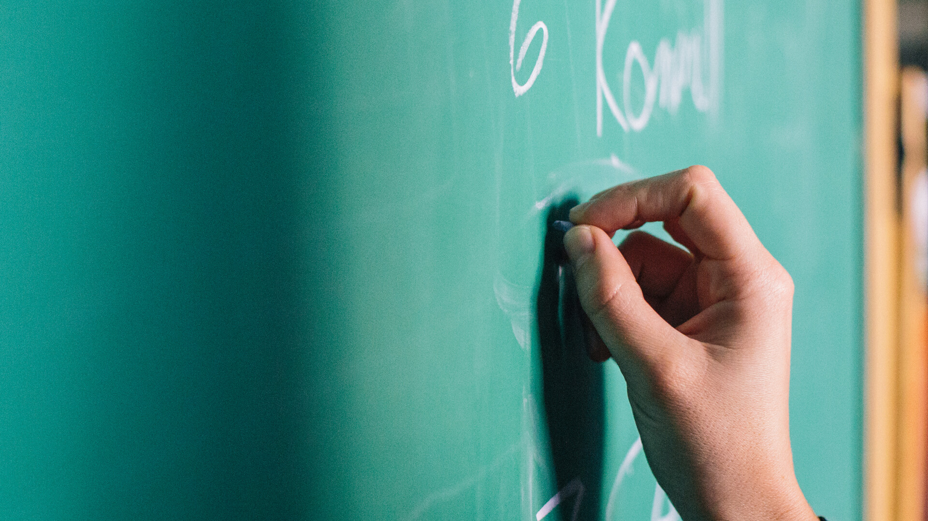
A PICTURE IS WORTH A THOUSAND WORDS
A complex idea can be conveyed with just a single still image, namely making it possible to absorb large amounts of data quickly.

Slide 30
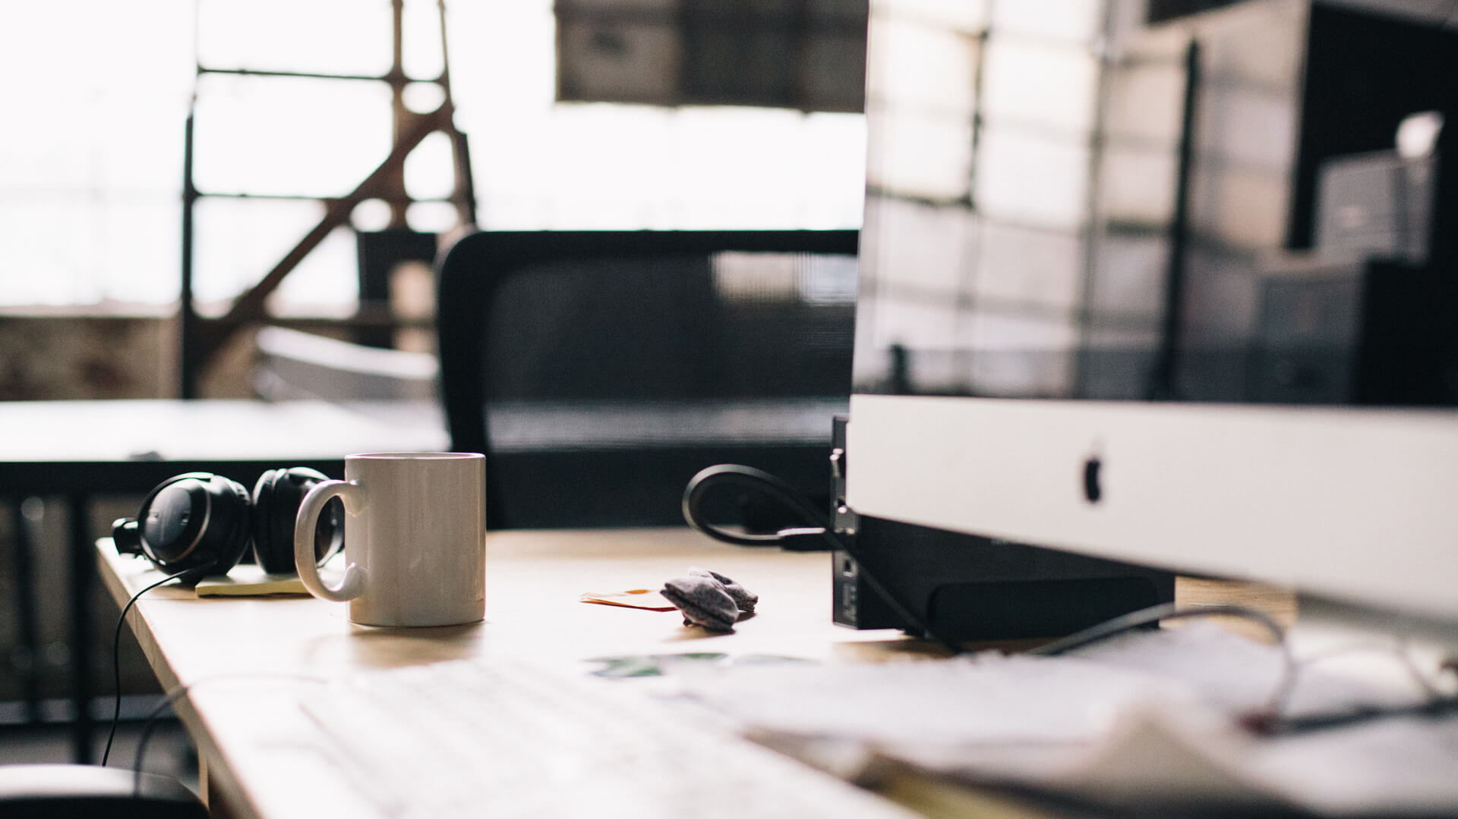
WANT BIG IMPACT?
Use big image.

Slide 31
USE CHARTS TO EXPLAIN YOUR IDEAS
WHITE
GRAY
BLACK

Slide 32
OR USE DIAGRAMS TO EXPLAIN COMPLEX IDEAS
01
Vestibulum nec congue tempus
Vestibulum nec congue tempus
Vestibulum nec congue tempus
03
02
Vestibulum nec congue tempus

Slide 33
AND TABLES TO COMPARE DATA
 | A | B | C
Yellow | 10 | 20 | 7
Blue | 30 | 15 | 10
Orange | 5 | 24 | 16

Slide 34

MAPS
our office

Slide 35
89,526,124
Whoa! That’s a big number, aren’t you proud?

Slide 36
89,526,124$
185,244 users
100%
That’s a lot of money
And a lot of users
Total success!

Slide 37
OUR PROCESS IS EASY
First
Second
Last

Slide 38
LET’S REVIEW SOME CONCEPTS
Yellow
Is the color of gold, butter and ripe lemons. In the spectrum of visible light, yellow is found between green and orange.
Blue
Is the colour of the clear sky and the deep sea. It is located between violet and green on the optical spectrum.
Red
Is the color of blood, and because of this it has historically been associated with sacrifice, danger and courage.
Yellow
Is the color of gold, butter and ripe lemons. In the spectrum of visible light, yellow is found between green and orange.
Blue
Is the colour of the clear sky and the deep sea. It is located between violet and green on the optical spectrum.
Red
Is the color of blood, and because of this it has historically been associated with sacrifice, danger and courage.

Slide 39
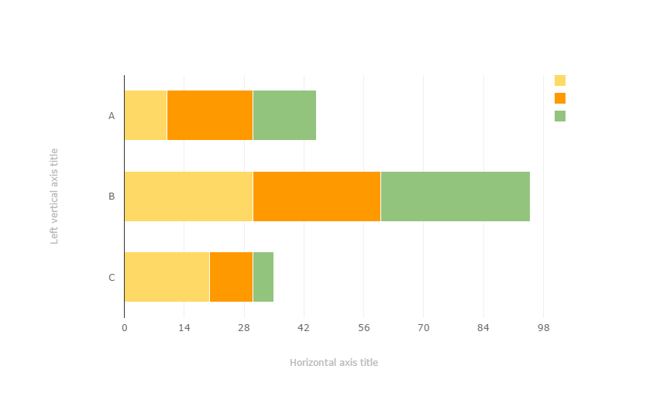
You can copy&paste graphs from Google Sheets

Slide 40
ANDROID PROJECT
Place your screenshot here
Show and explain your web, app or software projects using these gadget templates.

Slide 41
IPHONE PROJECT
Place your screenshot here
Show and explain your web, app or software projects using these gadget templates.

Slide 42
TABLET PROJECT
Place your screenshot here
Show and explain your web, app or software projects using these gadget templates.

Slide 43
DESKTOP PROJECT
Place your screenshot here
Show and explain your web, app or software projects using these gadget templates.

Slide 44
THANKS!
Any questions?
You can find me at @username & user@mail.me

Slide 45
CREDITS
Special thanks to all the people who made and released these awesome resources for free:
Presentation template by SlidesCarnival
Photographs by Death to the Stock Photo (license)

Slide 46
PRESENTATION DESIGN
You don’t need to keep this slide in your presentation. It’s only here to serve you as a design guide if you need to create new slides or download the fonts to edit the presentation in PowerPoint®
This presentations uses the following typographies and colors:
Titles: Montserrat
Body copy: Karla
You can download the fonts on these pages:
https://www.fontsquirrel.com/fonts/montserrat
https://www.fontsquirrel.com/fonts/karla
Red #F44336 Deep orange #FF5722 Orange #FF9800 Amber #FFC107
Yellow #FFEB3B Lime #CDDC39 Green #8BC34A Dark green #4CAF50
Teal #009688 Cyan #00BCD4 Blue #03A9F4 Dark blue #2196F3
Indigo #3F51B5 Deep Purple #673AB7 Purple #9C27B0 Magenta #E91E63
Blue gray #607D8B

Slide 47
SlidesCarnival icons are editable shapes.
This means that you can:
Resize them without losing quality.
Change line color, width and style.
Isn’t that nice? :)
Examples:

Slide 48
😉
Now you can use any emoji as an icon!
And of course it resizes without losing quality and you can change the color.
How? Follow Google instructions https://twitter.com/googledocs/status/730087240156643328
✋👆👉👍👤👦👧👨👩👪💃🏃💑❤😂😉😋😒😭👶😸🐟🍒🍔💣📌📖🔨🎃🎈🎨🏈🏰🌏🔌🔑 and many more...

